Slide 1
THREE PHASE ALTERNATOR/ SYNCHRONOUS GENERATOR

Slide 2
Principle of Operation
The operation of a synchronous generator is based on Faraday's law of electromagnetic induction, and in an ac synchronous generator the generation of emf's is by relative motion of conductors and magnetic flux.
These machines can be used as either motors or generators but their predominant use is in generation.
There are a number of sources of energy used to turn the turbines:-
(a) Gas (b) Steam (c) Combined cycle (d) Nuclear (e) Hydro (f) Wind (g) Wave (h) Photovoltaic

Slide 3
Principle of Operation
The revolving-fieldtype alternator has a stationary armature and a rotating magnetic field.
The voltage applied to generate the rotating field is a small DC voltage (called a “field excitation” voltage)
In case of alternator armature winding is mounted on a stationary element called stator and field winding is on a rotating element called rotor.
To maintain frequency constant the rotor must always move at synchronous speed.
Advantages of Stationary armature
Better insulation
Ease of current collection
Increased armature tooth strength
More rigid construction
Reduced armature leakage reactance
Lesser number of slip rings
Lesser rotor weight and inertia
Improved ventilation and heat dissipation

Slide 7
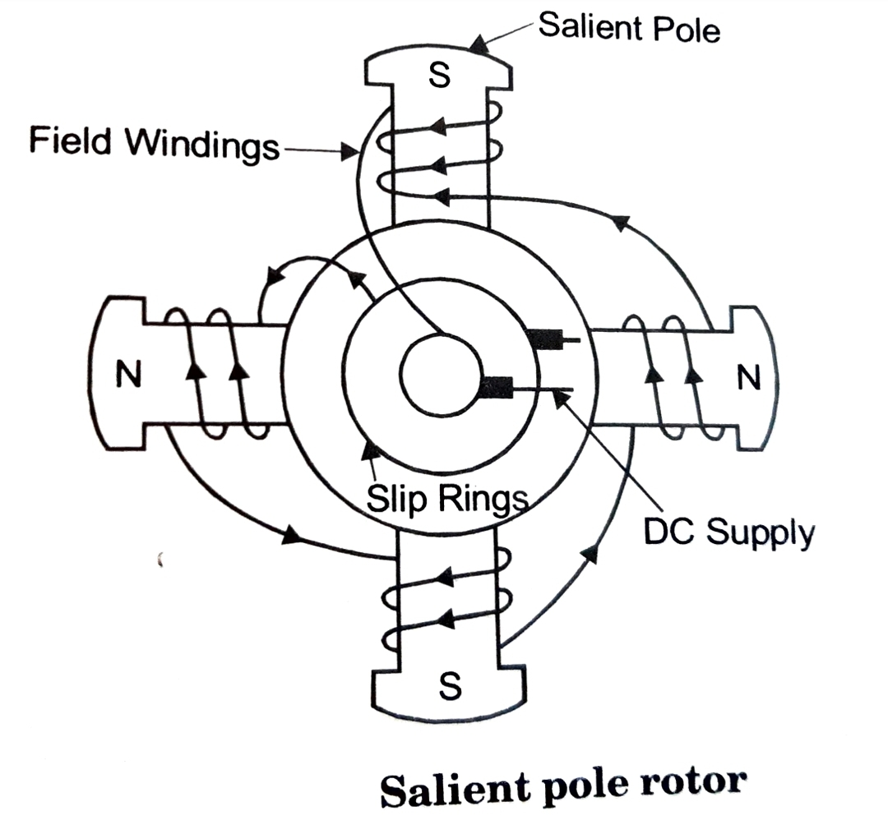

Slide 9
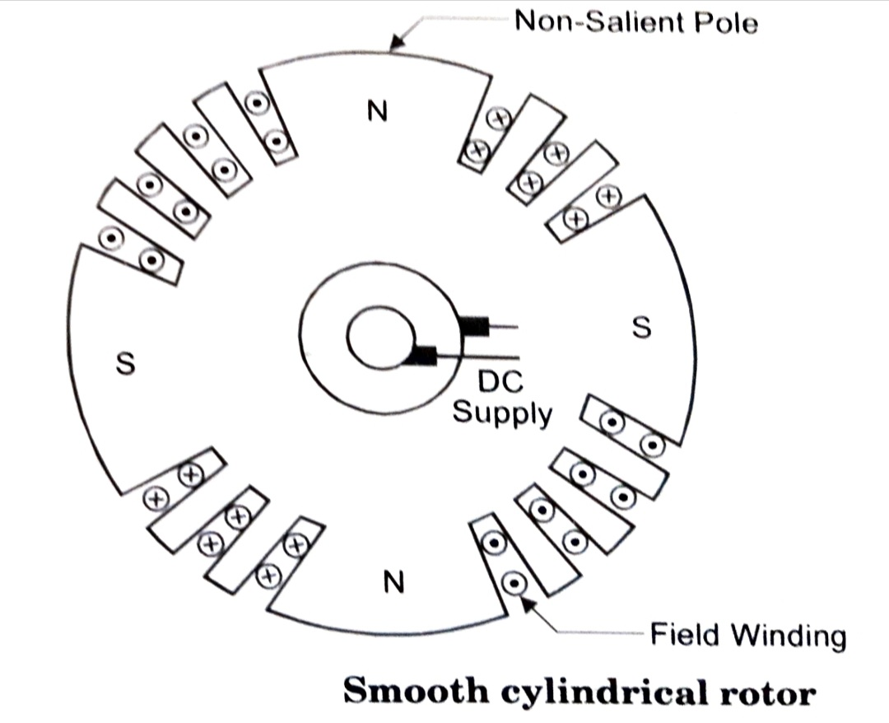

Slide 10
Working of alternator
As the rotor rotates, the armature conductors are cut by the magnetic flux. Hence an emf is induced in the armature conductors.
The frequency of the induced emf depends on the number of N and S poles and the speed of rotor.
Frequency of induced emf
The frquency of induced emf in the armature conductor depends upon the rotor speed and the number of poles
N - Rotor speed in rpm
P - Number of rotor poles
f - frquency of induced emf in Hz
Positive voltage is induced when a Npole sweeps across the conductor a similar negative voltage is induced when a S pole sweeps
Number of cycles/revolution = number of pairs of poles= P/2
Number of revolutions/second = N /60
Number of cycles/ seconds = (P/2)*(N/60)= (PN)/120
Frequency of induced emf is f= (PN)/120
Alternator must run at synchronous speed to give an output of desired frequency.

Slide 11
SYNCHRONOUS MOTOR

Slide 12
SYNCHRONOUS MOTOR
Synchronous motor is one type of 3 phase AC motor which operates at a constant speed from no load to full load
It’s used in many applications because of its fixed speed from no load to full load, its high efficiency and low initial cost
Also used to improve the power factor of 3phase AC industrial circuits

Slide 13
Principle of operation
When a sinusoidal voltage is applied to a winding, the magnetic field produced by the resultant current flow will also be sinusoidally varying with respect to time. Field is pulsating.
Ns = (120xf)/P

Slide 15
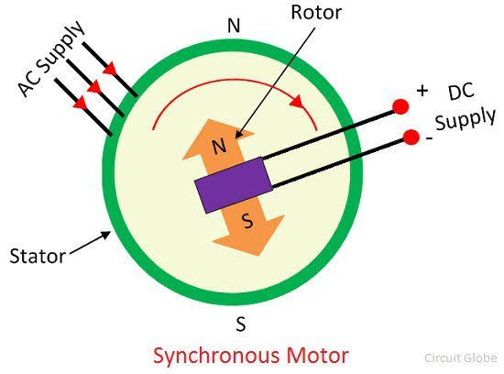
The rotor attracts towards the pole of the stator for the first half cycle of the supply and repels for the second half cycle.
Thus the rotor becomes pulsated only at one place. This is the reason because of which the synchronous motor is not self-starting.
The north and south poles of the rotor and the stator interlock each other. Thus, the rotor starts rotating at the speed of the rotating magnetic field. And the motor runs at a synchronous speed.

Slide 16
STARTING METHODS OF SYNCHRONOUS MOTOR
By using DC source
By means of Pony motor
By means of Damper Grid in the pole faces
As a slip ring Induction motor

Slide 21
As a slip ring Induction motor

Slide 22
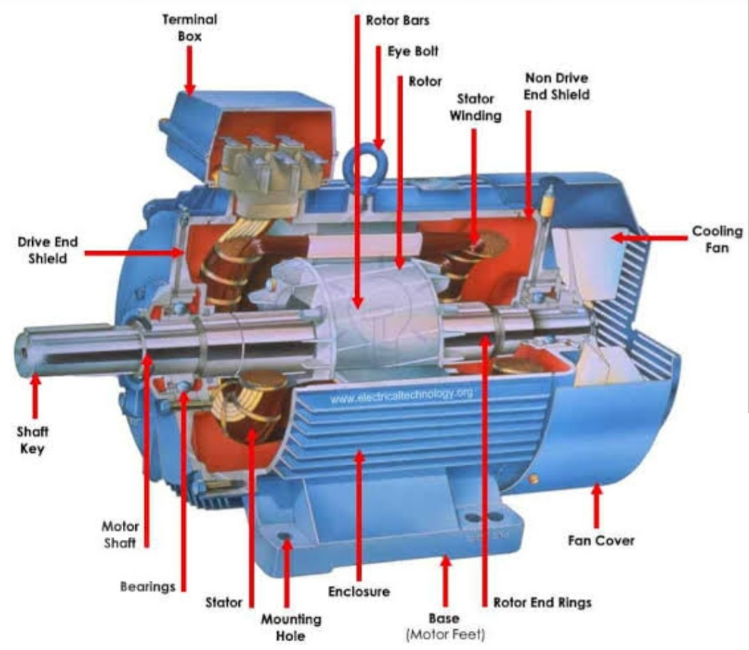
THREE PHASE INDUCTION MOTOR

Slide 23
THREE PHASE INDUCTION MOTOR
Extensively used for electric drives
Advantages:
1. Simple construction 2. High reliability
3. Low cost 4. High efficiency
5. Less maintenance 6. Self starting
7. Good power factor
Disadvantages:
Speed is not constant when load is varied
Low starting torque
Reduction in efficiency when speed is varied

Slide 24
PRINCIPLE OF OPERATION
3Phase supply is given to the stator winding
Due to this, current flows through the stator winding is called stator current
It produces a rotating magnetic field in the space between stator and rotor.
The magnetic field rotates at synchronous speed
Ns=(120f)/P
Ns---->Synchronous speed
f-------> Supply frquency
P-------> Number of poles for which stator is wound
The interaction of stator & rotor field develops torque
In an induction motor the rotor speed is always less than sychronous speed.
The difference between synchronous speed and rotor speed is called slip speed
Slip speed=Ns- N
Slip S= (Ns-N)/Ns
%slip=((Ns-N)/Ns)*100

Slide 25
At no load the difference between synchronous speed and rotor speed is only abou 1%
Under steady state condition the electromagnetic torque is equal to the load torque
At full load condition the difference between synchronous speed and rotor speed is about 3 to 5%

Slide 26
Constructional Details
Two main parts of induction Motor - Stator & Rotor
Stator
Made up of number of stampings with alternate slots and tooth
Stampings are insulated from each , each stamping is 0.4 to 0.5mm thick.
3phase winding is called stator winding, may be connected in star or delta
Stator winding is made for a fixed number of poles

Slide 27
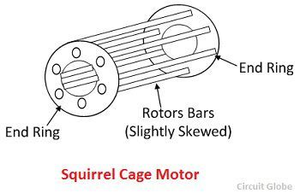
ROTOR 1. Squirrel Cage rotor
2. Slip ring or wound rotor
1. Squirrel Cage rotor
Cylindrical laminated core with slots to carry the rotor conductors
Rotor conductors are heavy bars of copper or aluminium short circuited at both ends by end rings.Hence this motor is called short circuited rotor
Entire rotor resistance is very small
External resisitance cannot be connected in the rotor circuit. Motors using such rotors are called squirrel cage induction motor
Majority of induction motors are cage rotors.

Slide 28
Advantages of Squirrel cage Induction motor:
Cheaper
Light weight
More efficient
Require less maintanance
Disadvantages of Squirrel cage Induction motor:
Moderate starting torque
External resistance cannot be connected to rotor circuit. So starting torque cannot be controlled
Applications:
Lathes Water pumps
Drilling machines
Grinders
Fans
Printing machines
Blowers

Slide 29
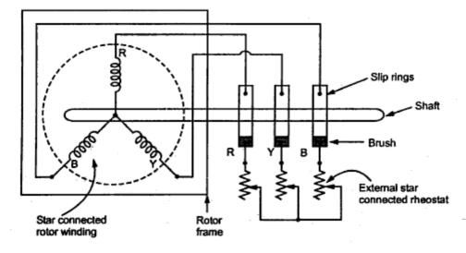
2. Slip ring or wound rotor
Rotor windings may be star or delta connected, distributed winding
By varying the external resistance in the rotor circuit the motor speed and torque can be controlled

Slide 30
Advantages of Slip ring Induction motor:
Starting torque & Speed of the motor can be controlled by varying the rotor circuit resistance
Disadvantages of Squirrel cage Induction motor:
Heavier machine
High cost
High rotor inertia
High speed limitation
Applications:
Lift
Cranes
Elevators
Compressors

